Slide 1
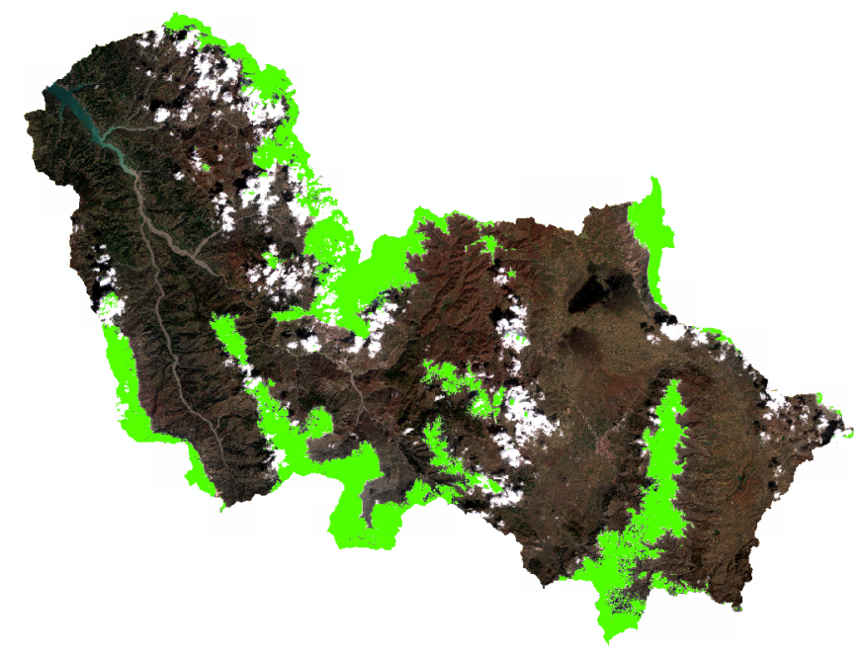
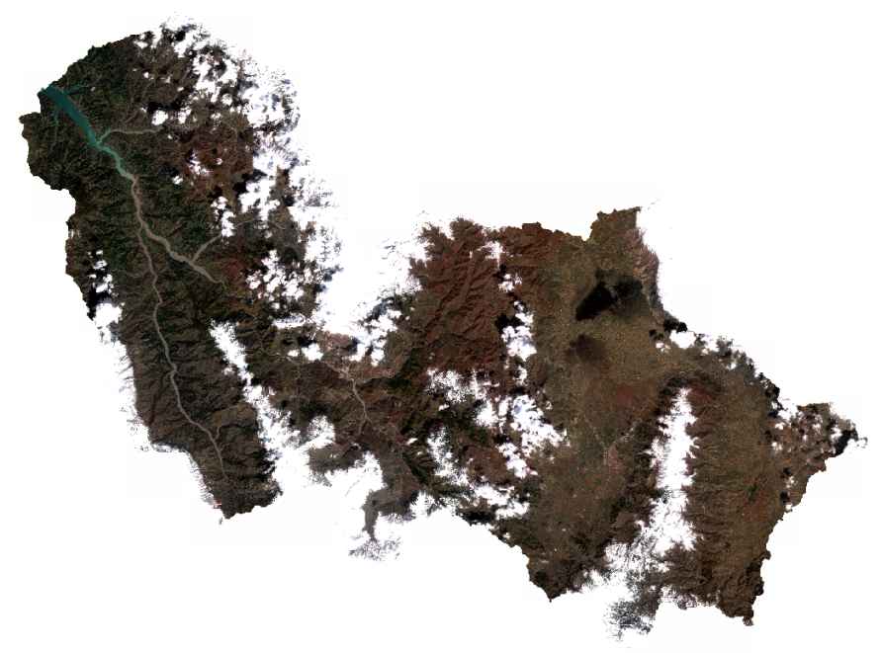
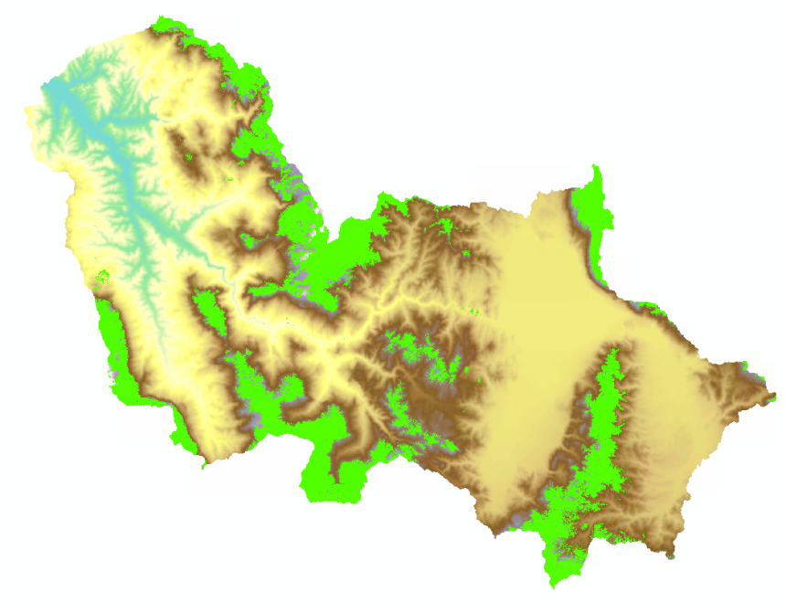
Snow detection
Notes:
Leichte Bewölkung gar kein Problem, kann durch den Code sehr gut gehandled werden
→ Ergebnis mit Satellitenbild und DEM, zeigt auch unter Wolken sehr plausible Ergebnisse. Schnee an den Berggipfeln

Slide 2
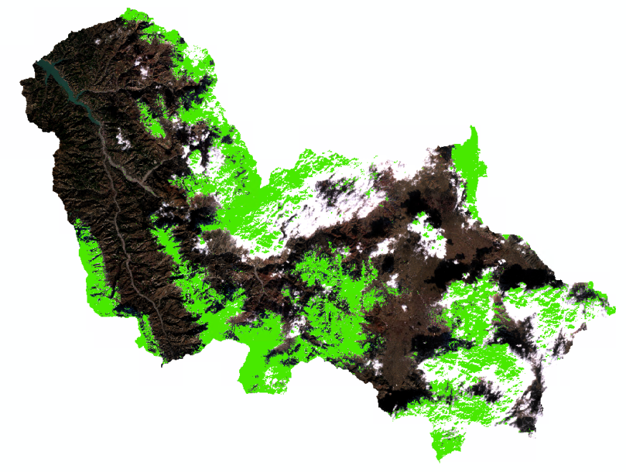
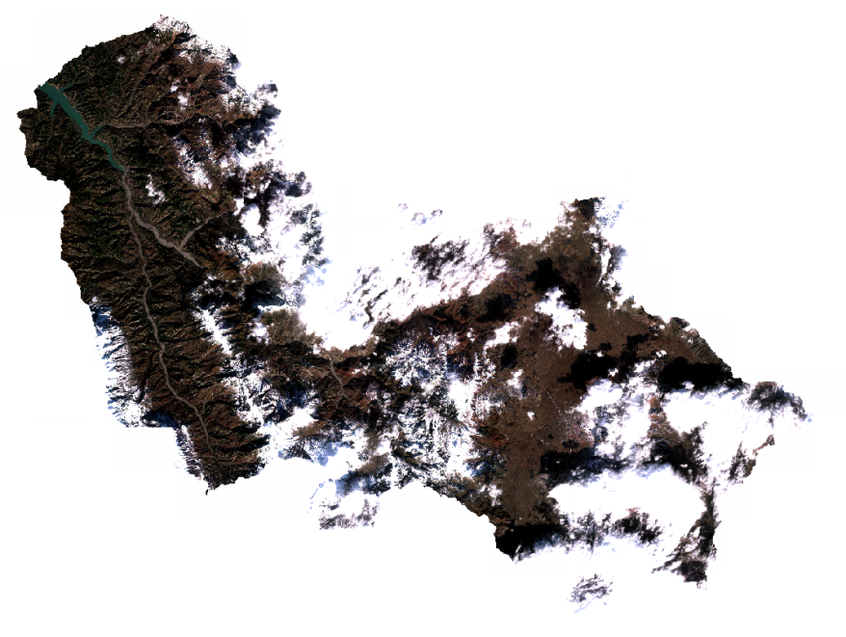
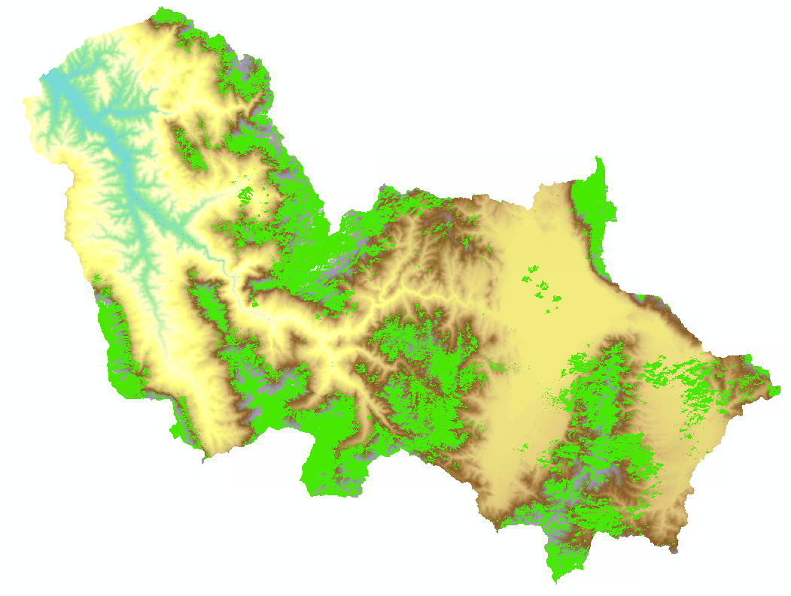
Snow detection
Notes:
Problem when wee have very dense cloud covers

Slide 3
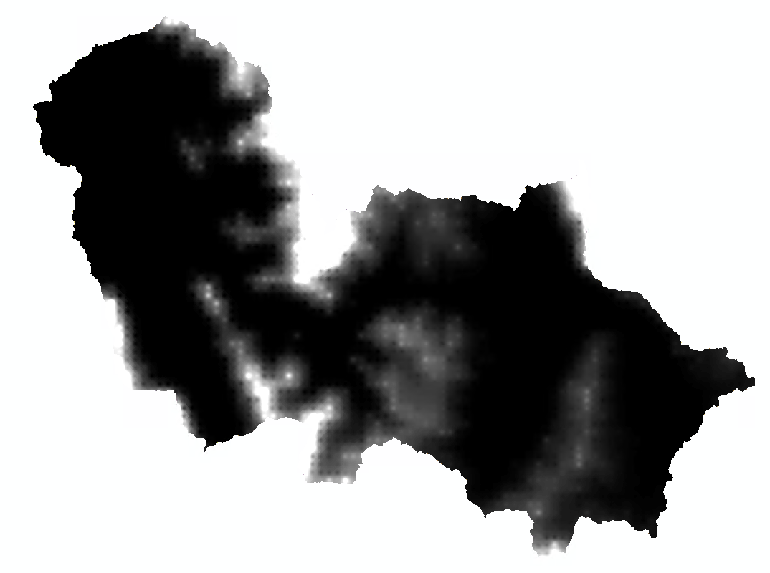
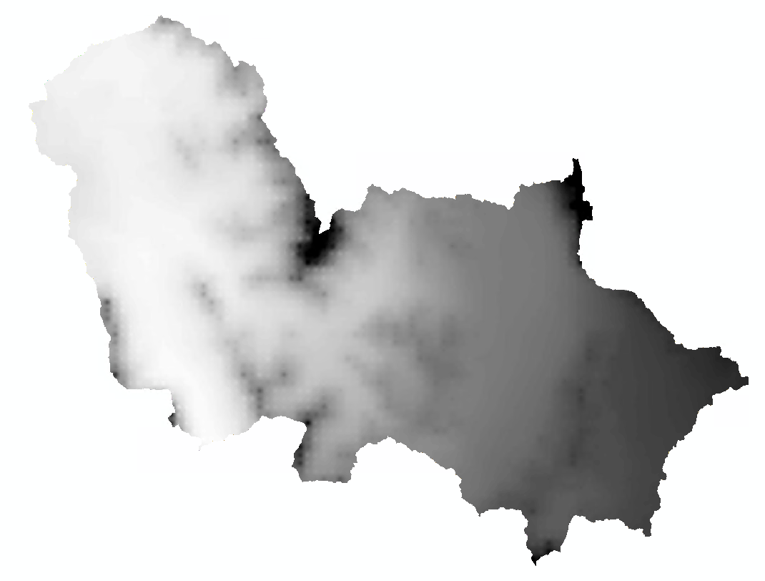
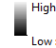
Snow or Rain ?
Differentiation depending on the temperature
Snow
Rain
Notes:
Hourly text files for Rain and Snow are transferred into a Snow and Rain raster for each month (EroSnow1.py) → Inverse Distance Weighting to get the Raster in finer resolution (until now not implemented in Python, currently carried out in ArcGIS)

Slide 4
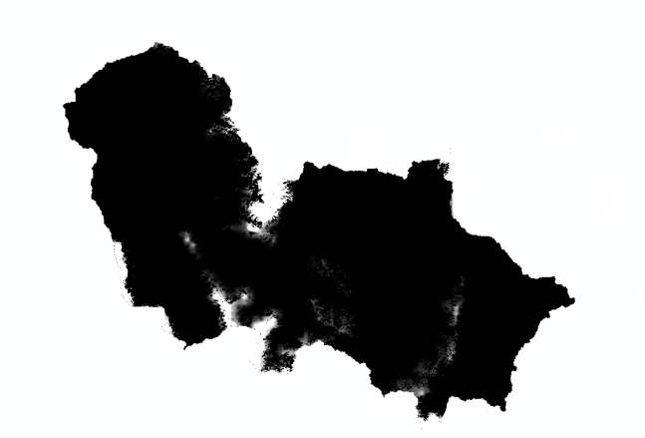
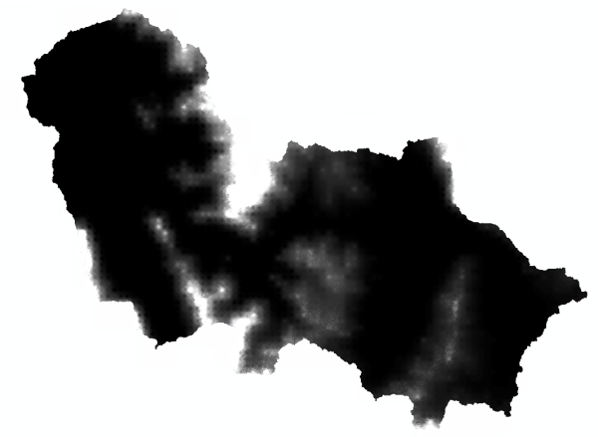
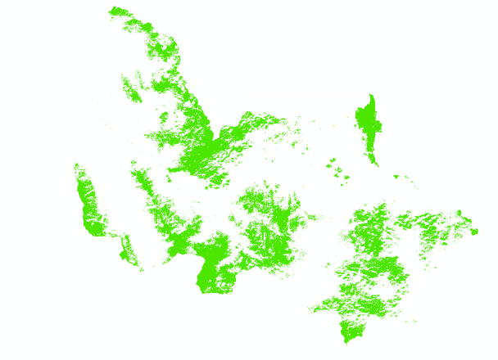
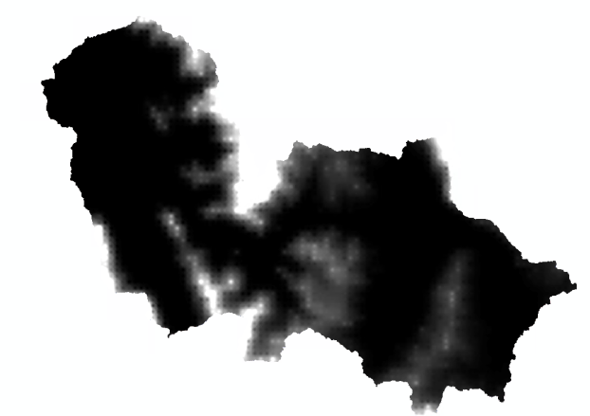

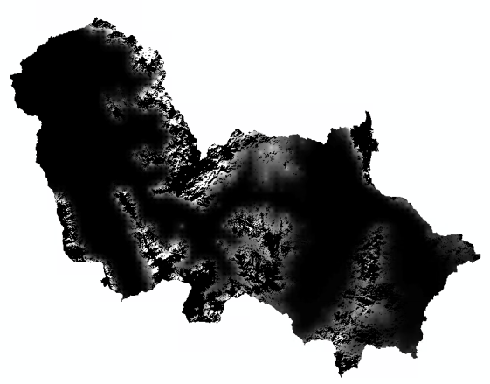
Snow End November (mm)
Snow Sum December (mm)
Snow Cover End of December
Snow New December (mm)
Snow End December (mm)
Transferred to January
Erosive in December
Snowmelt December (mm)
Snow Sum – Snow End December
Notes:
Nothing in between, the snow is totally melted or summed together, still better because you normally don’t distinguish between rain and snow or the snow is considered as completely non-erosive

Slide 5
Workflow
Snow detection (Snow_detection.py)
Pre- and Postprocess input temp and prec rasters (RasterManipulation_2.py)
Snow or Rain distinguishment (EroSnow1.py)
Resample Snow and Rain Raster (Snow_Prec Raster Modification, arcpy)
Calculate snow sum = Snow_end_previous_month + Snow_current_month
Multiply snow cover (Snow detection) with snow sum (Raster Calculator) → snow_end_month (transferred to following month)
Snow sum – snow_end_month → snow melt, erosive in this year
Calculate R-factor for each month based on Rain (REM_db)
Add the snow melt to the monthly R-factor but how to calculate the erosivity?
It would be perfect to implement all the steps into Python!
For the project we could also pick only one part!

Slide 6
Approach

Slide 7
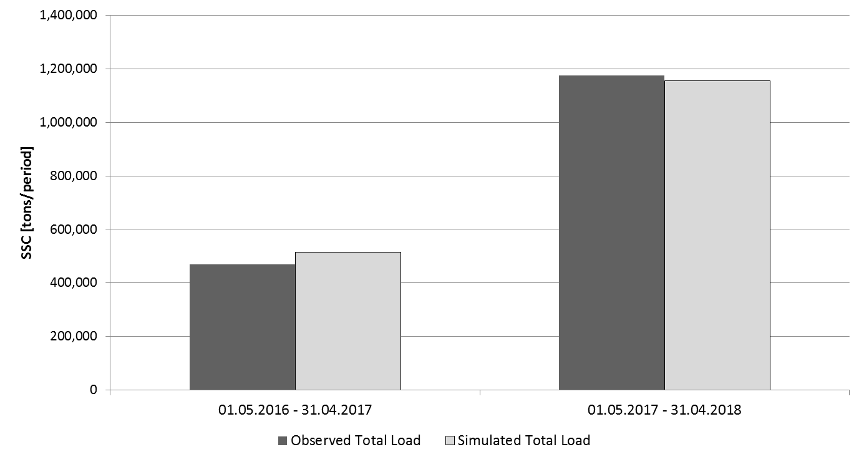
Annual load (Standard)
Notes:
Good results without including snowmelt and distinguishment between rain and snow.

Slide 8
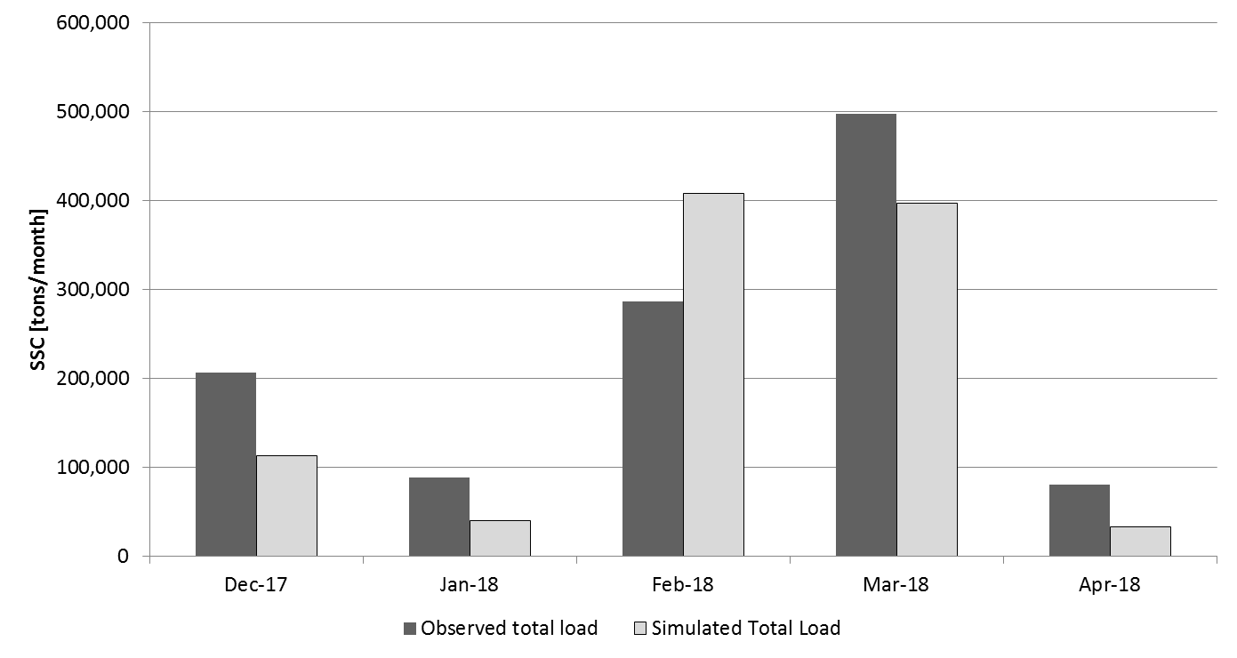
Monthly load (Standard)
Snowmelt?
Snow?
Notes:
Trend wird gut abgebildet, aber wie schon oft besprochen haben wir im Februar deutlich weniger Schwebstoffe als berechnet und im März deutlich mehr.
Gleich viel Niederschlag in beiden Monaten
Hypthese: Schneeschmelze und Schneefall

Slide 9
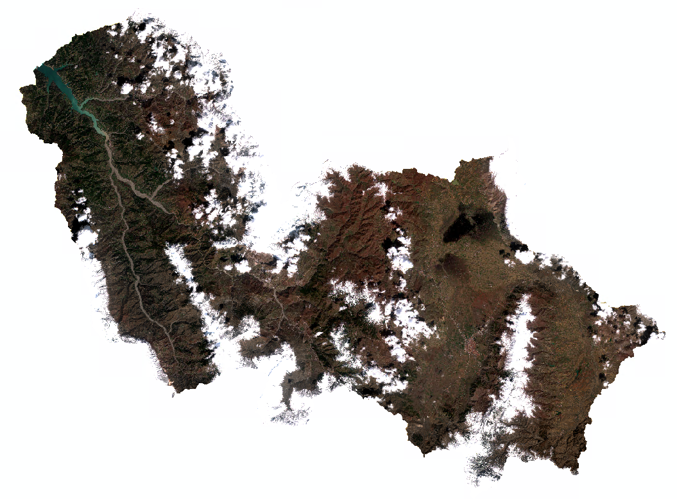
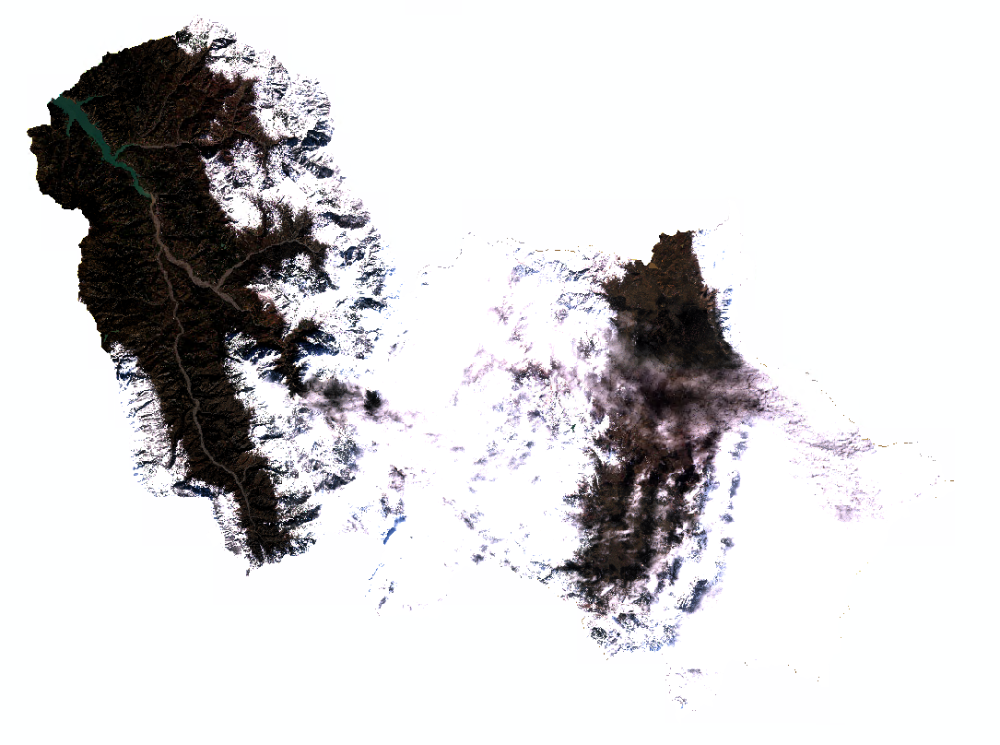
28.03.18
16.02.18

Slide 10
Monthly load (Standard)

Slide 11
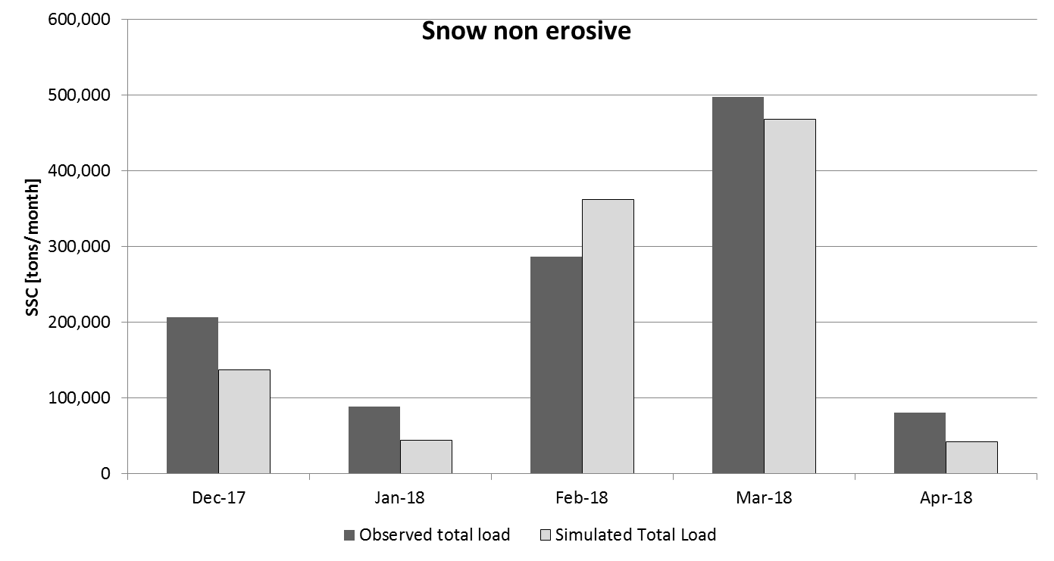
Monthly load (Snow non erosive)
Notes:
Set a threshold where we have snow instead of rain → only rain is erosive
Simulated load decreases in months with a lot of snowfall.
Simulated load for February and march is now very different because of the distinguishment

Slide 12

Monthly load (Snow non erosive + snowmelt)
Notes:
Results are further increased but not that drastically

Slide 13

Monthly load (Snow non erosive + snowmelt)

Slide 14
Summary
Simulation | R-factor | Difference Total SSC [%] | RMSE [kt]
No snow consideration | REM_DB(Precipitation) | -14.45% | 171.97
Snow is non erosive | REM_DB(Rain) | -9.09% | 97.57
Snow is non erosive but snowmelt (a) | REM_DB(Rain) + 0.7 * snowmelt(mm) | -8.50% | 88.74
Snow is non erosive but snowmelt (b) | REM_DB(Rain) + 1.0 * snowmelt(mm) | -8.30% | 85.27
Snow is non erosive but snowmelt (c) | REM_DB(Rain) + 1.3 * snowmelt(mm) | -8.12% | 81.98
REM_DB(Rain) is approx. 1.3 * rain (mm)
Notes:
Version c means that one mm of snow is similar erosive than one mm of rain → question is if results will further increase by considering the snowmelt as more erosive.
RMSE wird mehr als halbiert!

